Slide 1

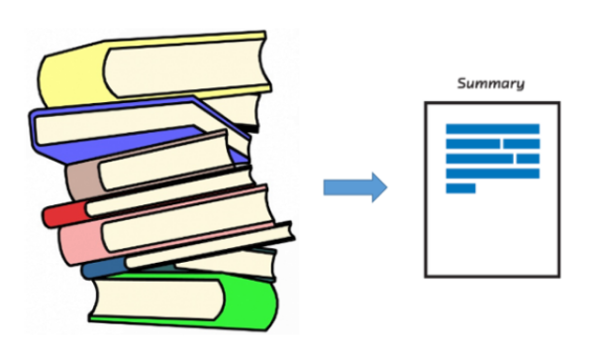
Document Summarization

Slide 2
Document Summarization
Take an information source,
extract content from it,
and
present the most important content to the user
in a condensed form,
in a manner sensitive
to the user’s or
application’s needs.

Slide 3
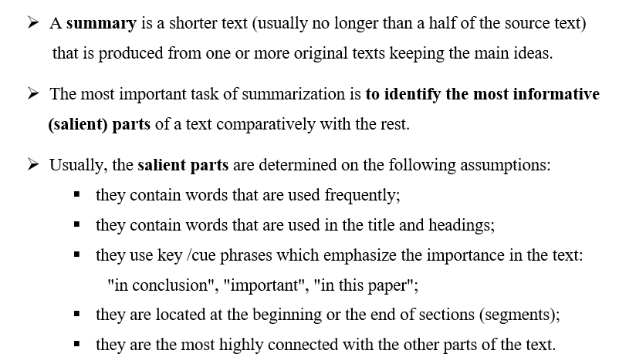
Summary

Slide 4
Automatic summarization
The process by which a computer program creates
a shortened version of text.
Three important aspects characterize research on automatic summarization:
  Summaries may be produced from a single document or multiple documents;
  Summaries should preserve important information;
  Summaries should be short and coherent.

Slide 5
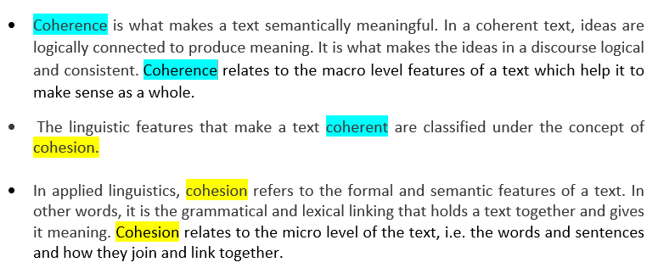
Two main components are important in content writing: coherence and cohesion

Slide 6
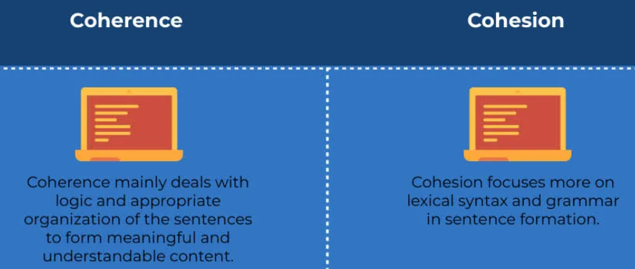
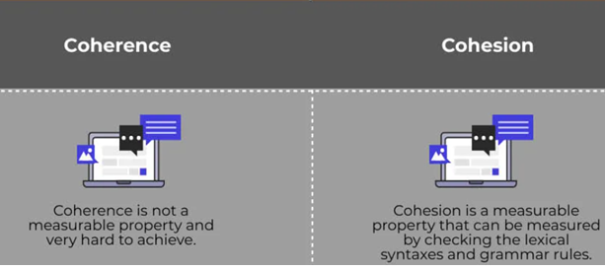

Slide 7
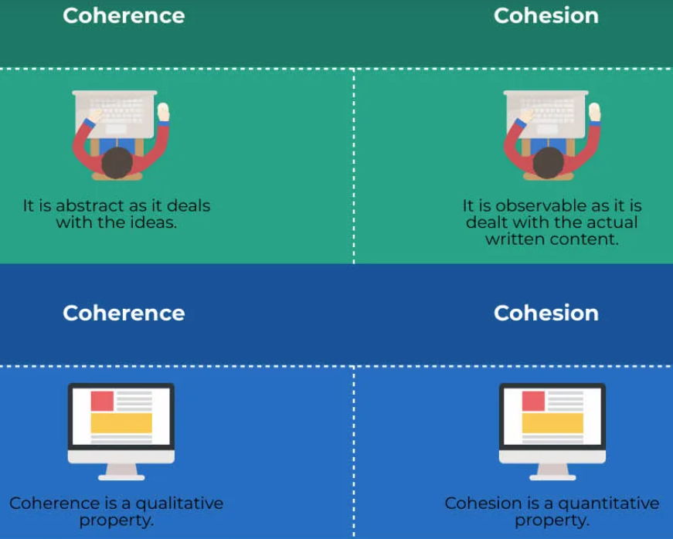

Slide 8
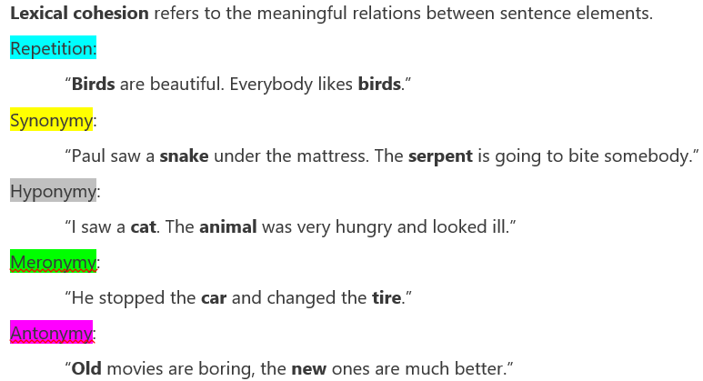
Examples of cohesion

Slide 9
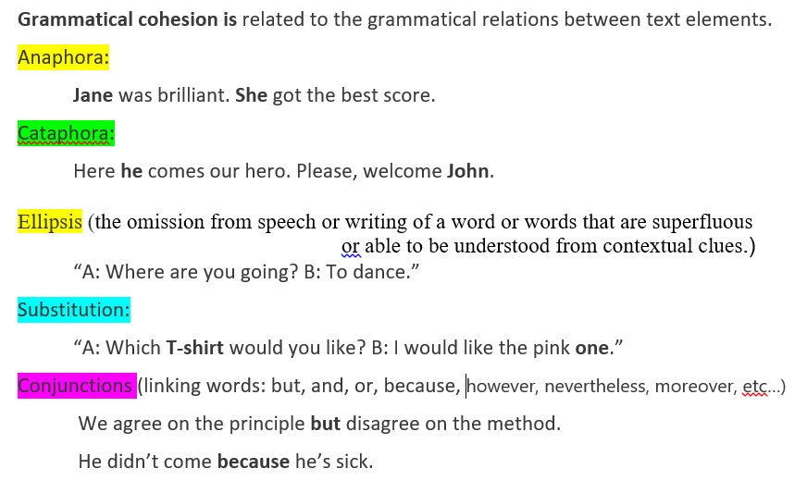
Examples of cohesion

Slide 10
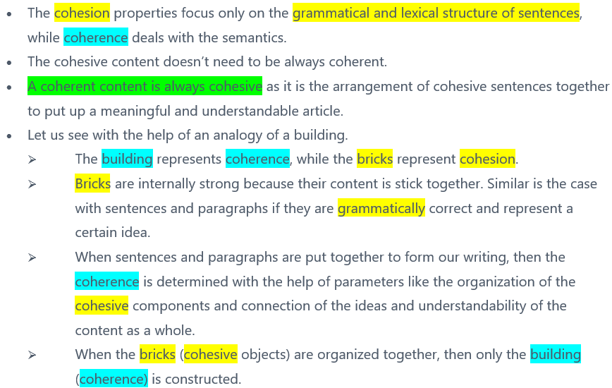
Cohesion and Coherence

Slide 11
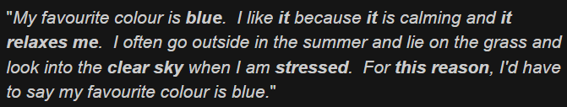
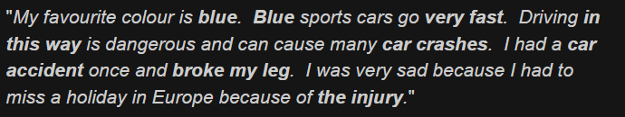

Coherence and Cohesion - examples
Coherent and cohesive
Not coherent but cohesive
Not coherent but cohesive

Slide 12
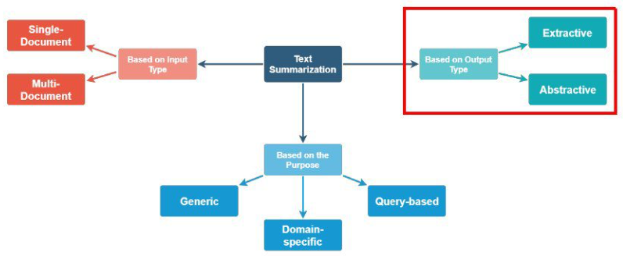
Automated text summarization approaches

Slide 13
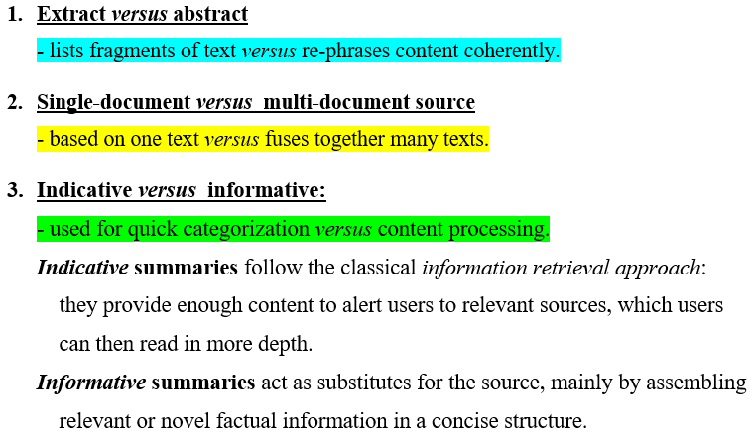
Genres of a summary

Slide 14
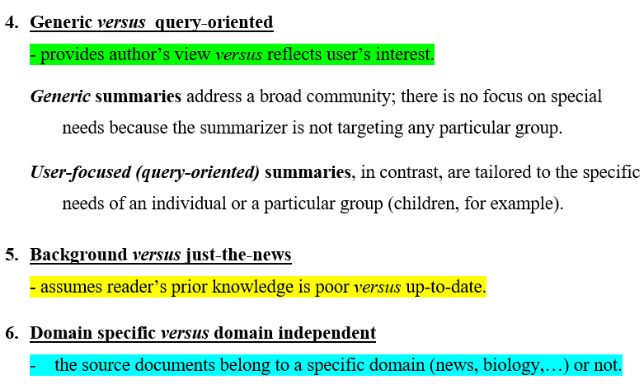
Genres of a summary (contd.)

Slide 15
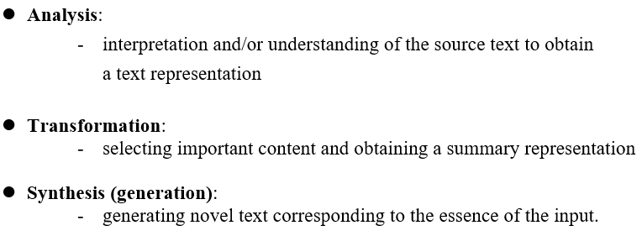
Stages of summarization

Slide 16
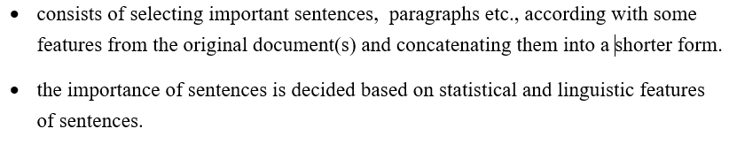
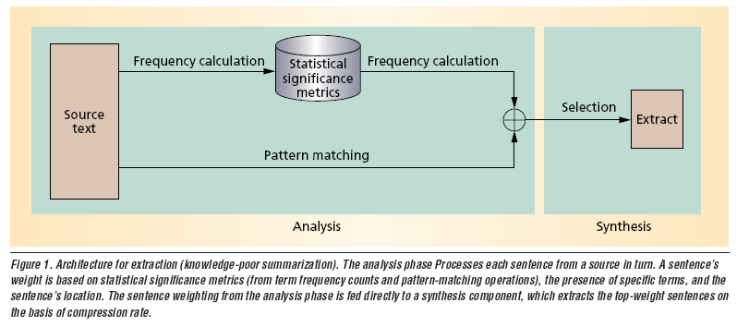
extractive summarization

Slide 17
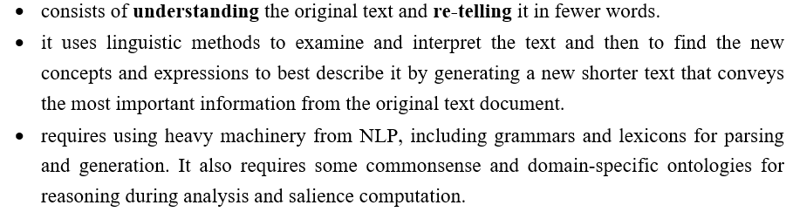
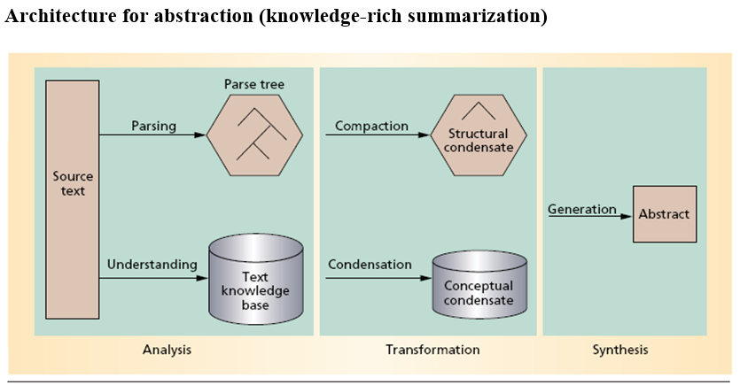
abstractive summarization

Slide 18
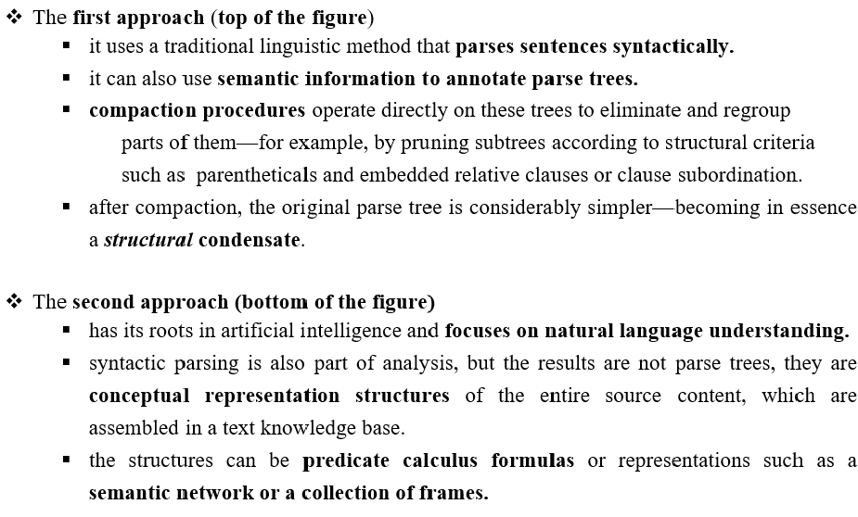
ABSTRACTIVE SUMMARIZATION: analysis phase

Slide 19
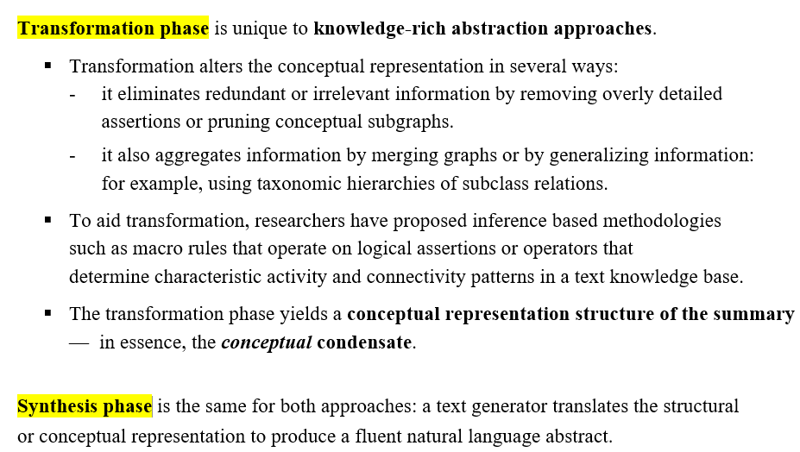
ABSTRACTIVE SUMMARIZATION

Slide 20
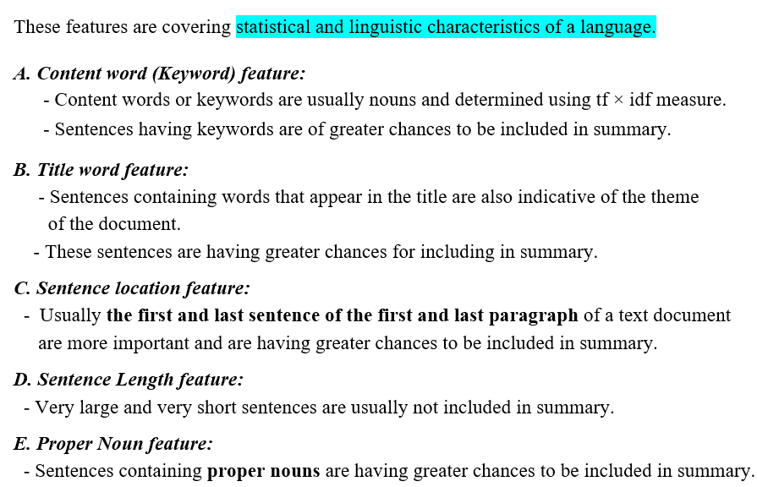
Features for extractive text summarization

Slide 21
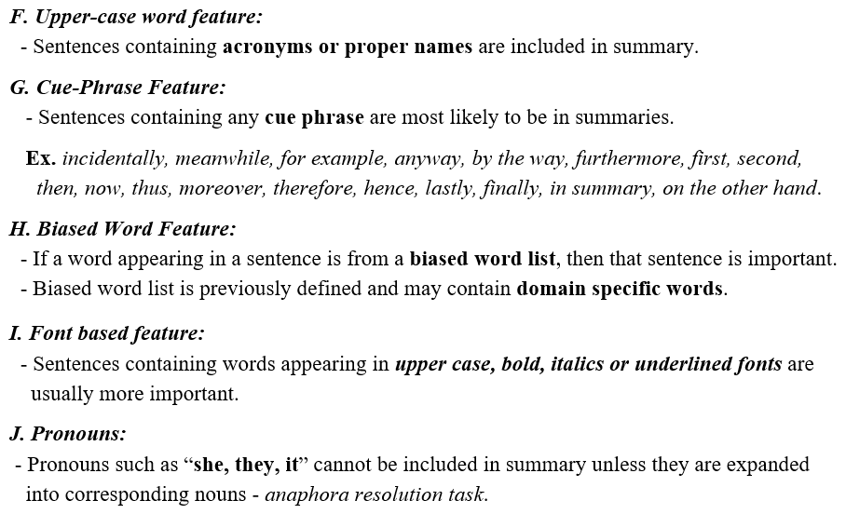
Features for extractive text summarization

Slide 22
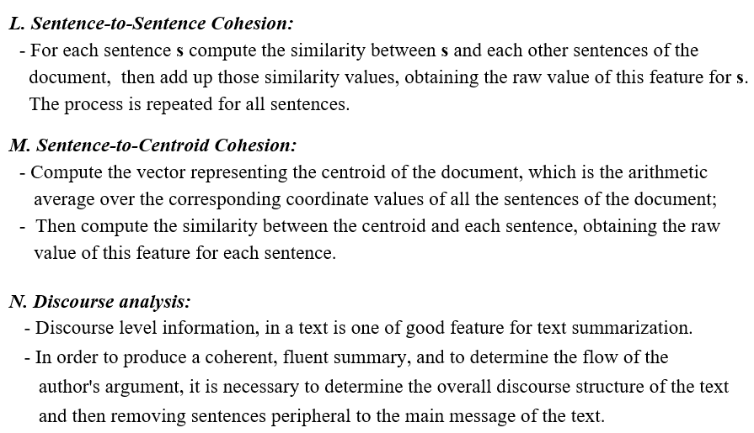
Features for extractive text summarization

Slide 23
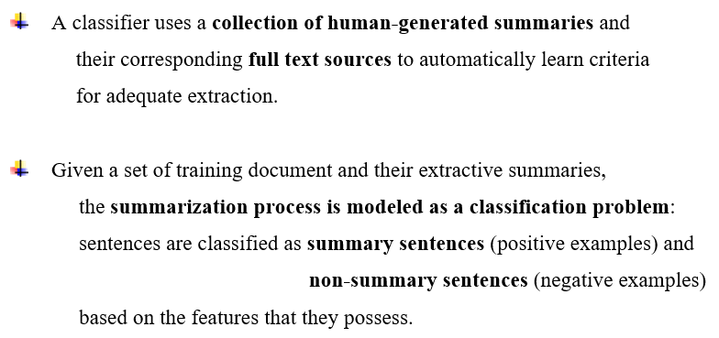
Machine learning approach

Slide 24
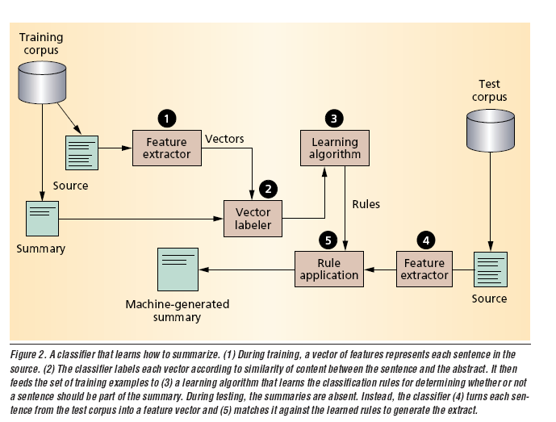
Machine learning approach

Slide 25
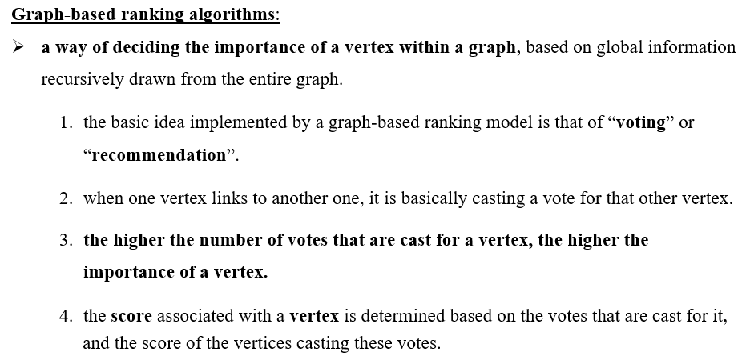
I. Graph-based Ranking Algorithms for Sentence Extraction, Rada Mihalcea, 2004

Slide 26
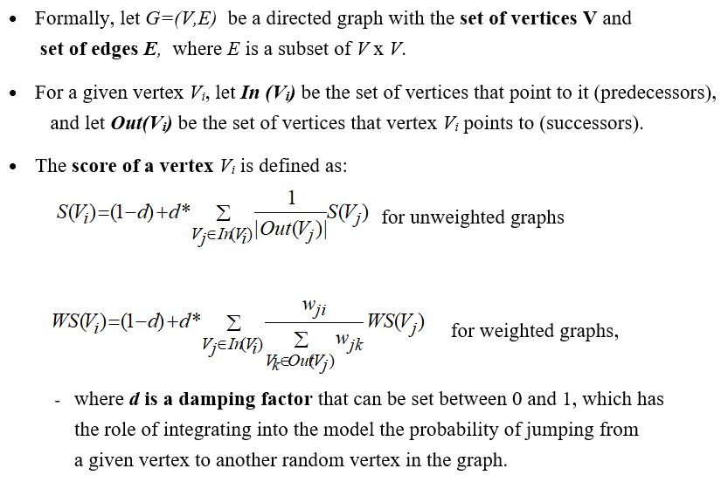
Graph-based Ranking model

Slide 27
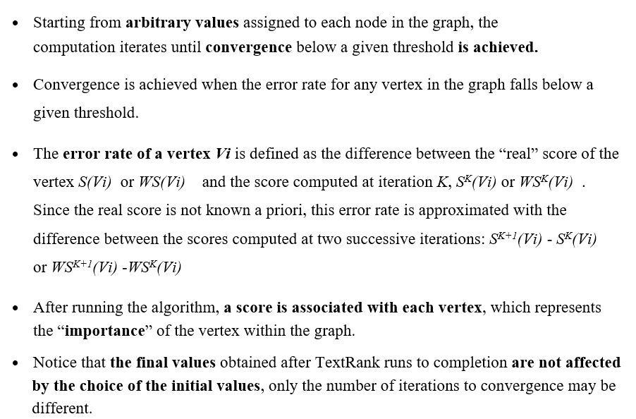
Graph-based Ranking Algorithm

Slide 28
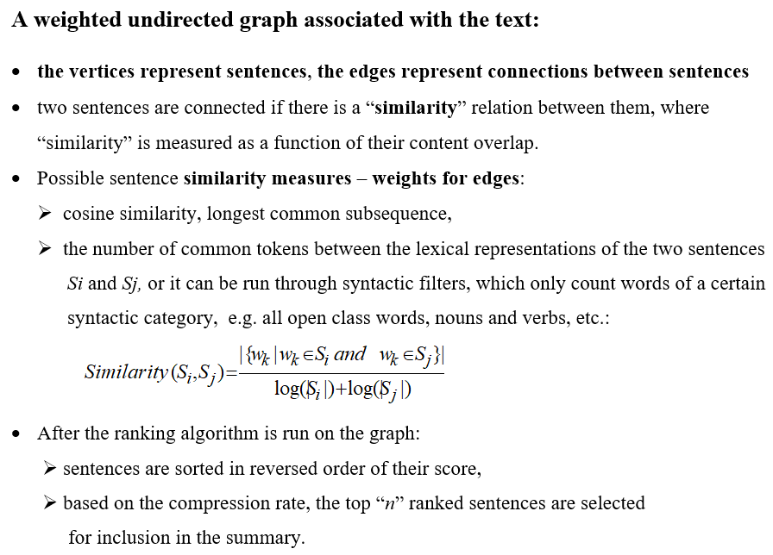
Sentence extraction with TextRank

Slide 29
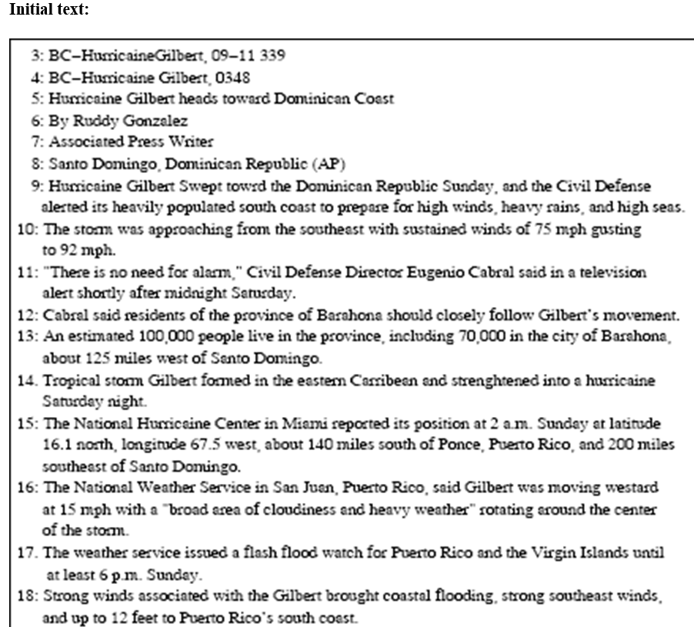

Slide 30
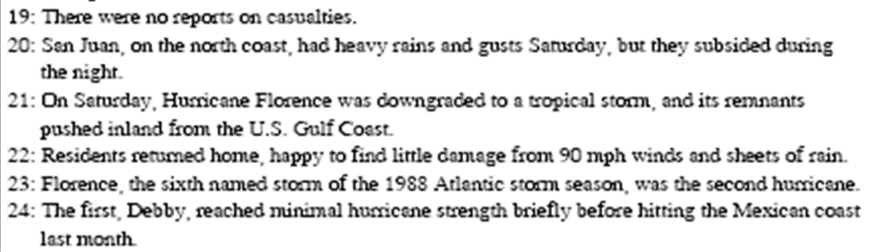
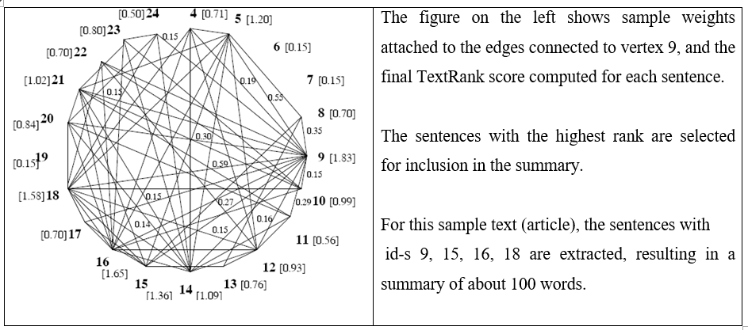

Slide 31
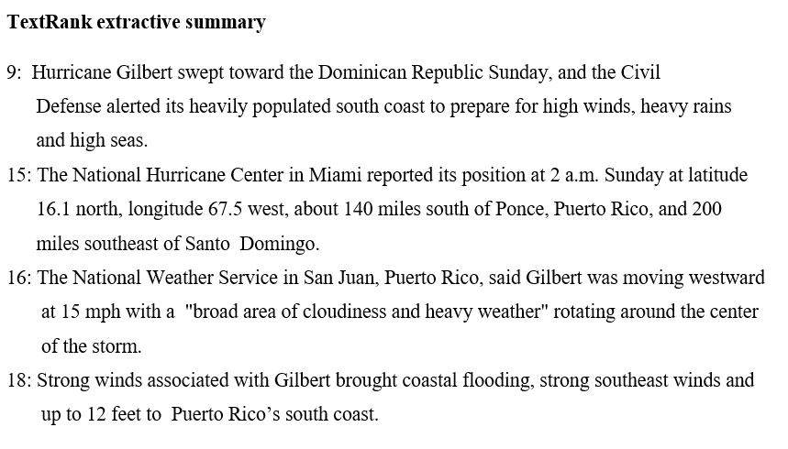

Slide 32
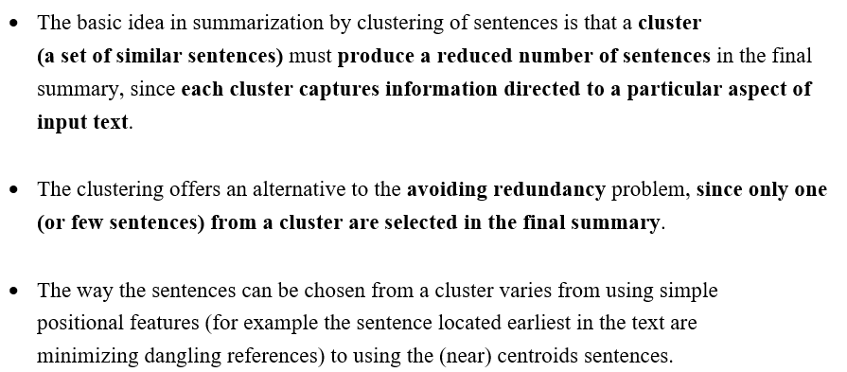
II Summarization by clustering – single document summarization

Slide 33
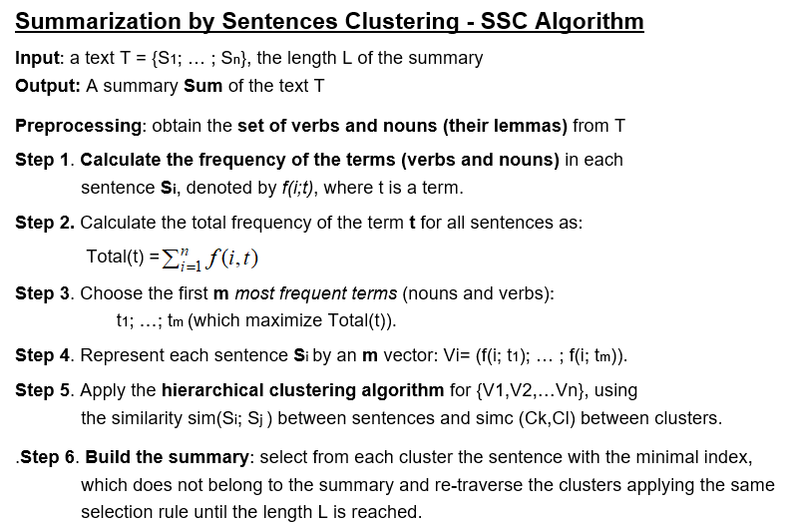

Slide 34
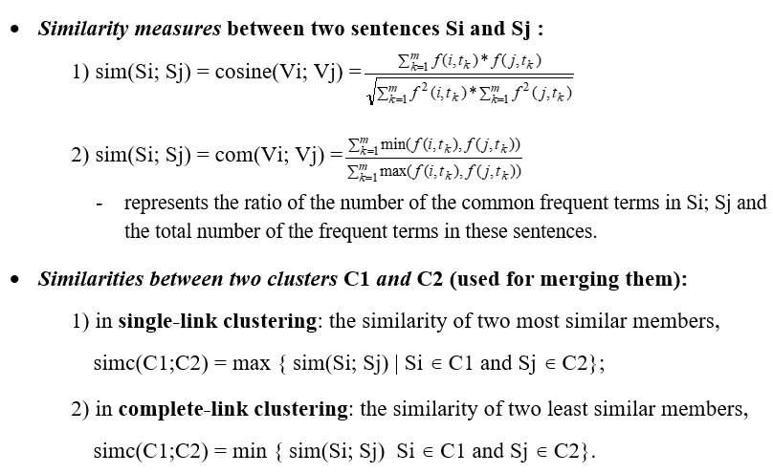
Clustering - Similarity measures

Slide 35
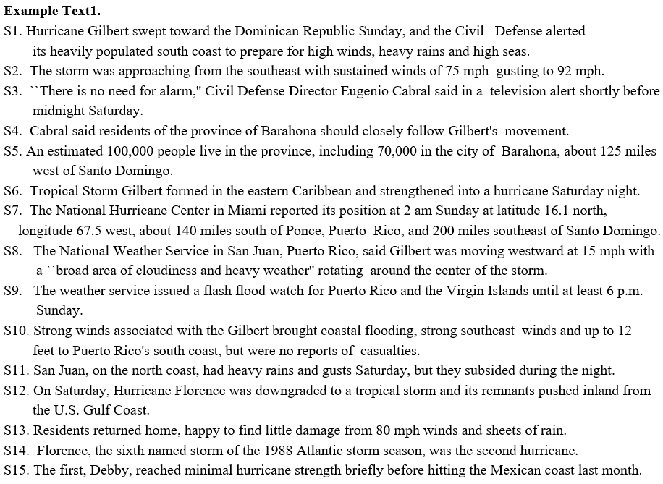

Slide 36
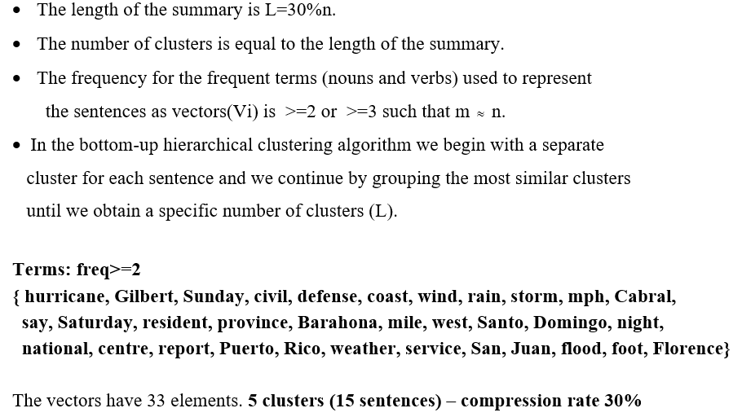
SSC- applied to Text1

Slide 37
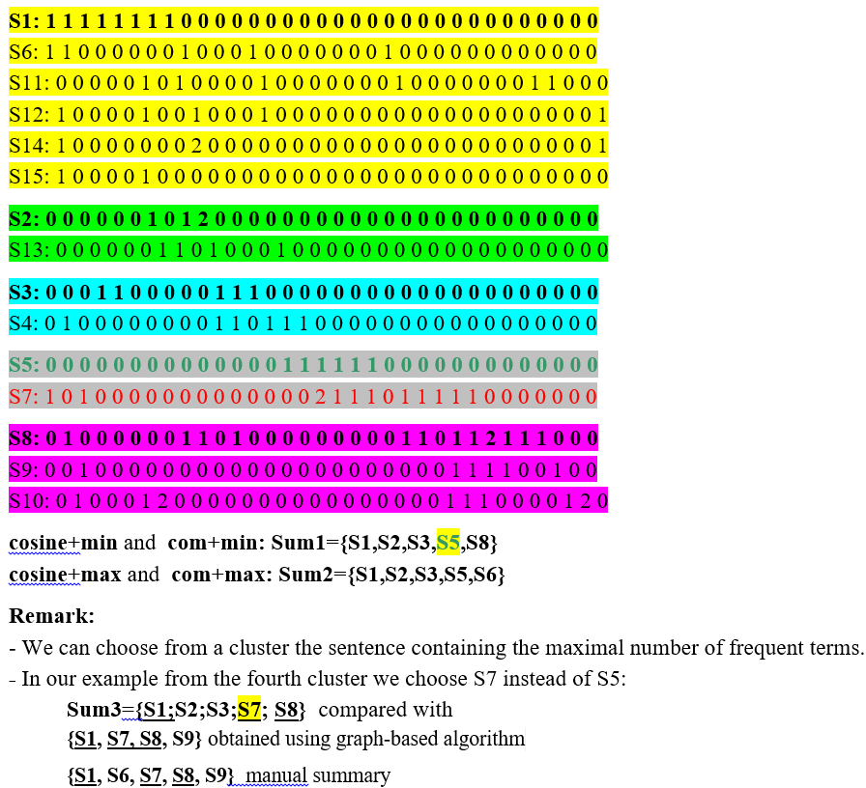
Text1-Results

Slide 38
Online summarizers
https://quillbot.com/summarize
https://www.textcompactor.com/
https://www.tools4noobs.com/summarize/

Slide 39
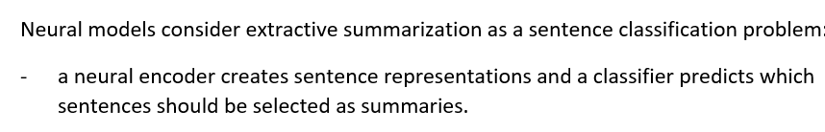
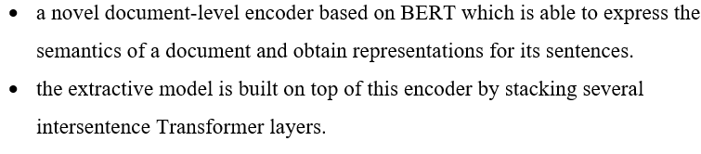
BERTSUM - Extractive summarization using BERT-
BERTSUM

Slide 40
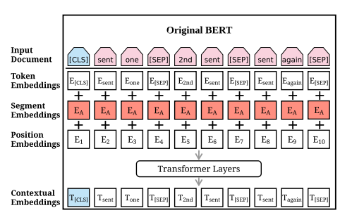
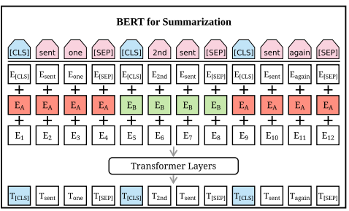
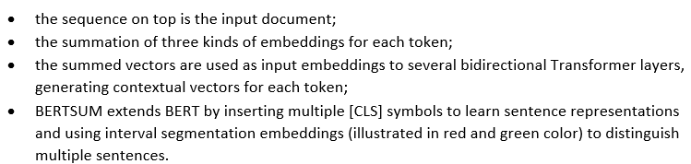
BERTSUM

Slide 41
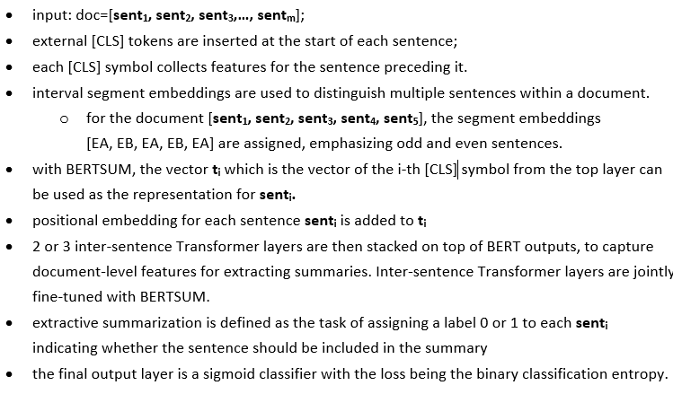
BERTSum - description

Slide 42
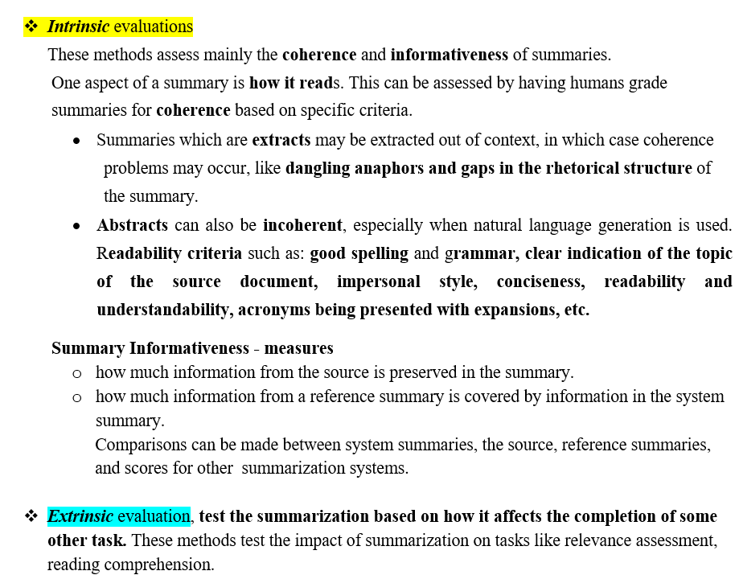
Methods for evaluating text summarization

Slide 43
